Slide 1
Predictive modeling for optimal
power management in photovoltaic systems
addressing regulatory constraints
with Machine Learning
PhD. Alejandro Pérez Núñez
Technology Center (anonymized)

Slide 2
Problem definition
Spanish Framework

Slide 3
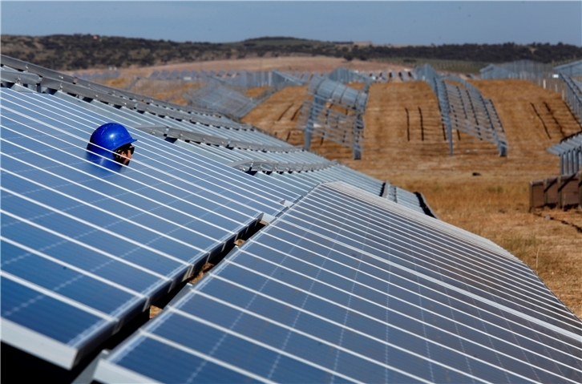
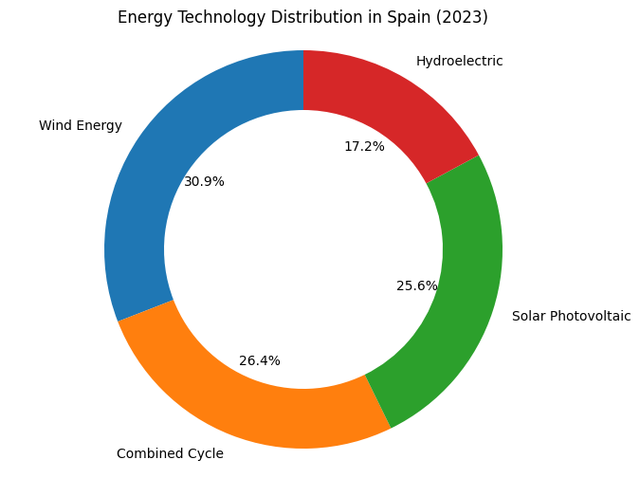
Problem definition – Spanish Framework
Producers: connected to the grid
2023
+ 5,594 MW solar photovoltaic capacity
+ 15,1% yearly increasement
Reference: Spanish Electrical Grid – Public Company (REE, ree.es)
Notes:
There are two primary players in the Spanish photovoltaic market, and they must be compared in terms of their relationship with the public power grid.
Producers are those who are connected to and sell their energy to the Spanish National Power Grid.
This market accounts for nearly 26% of the total energy distribution in Spain and is growing rapidly at a rate of15%.

Slide 4
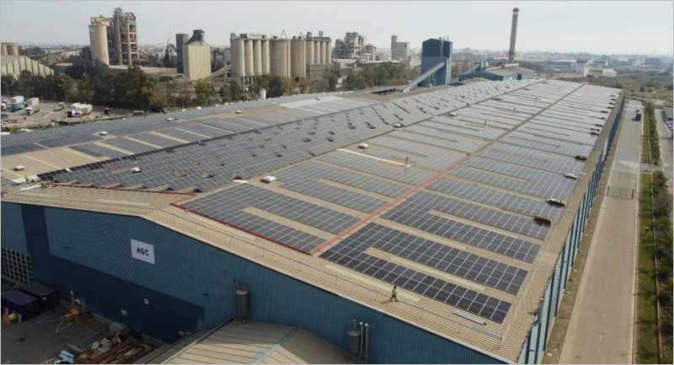
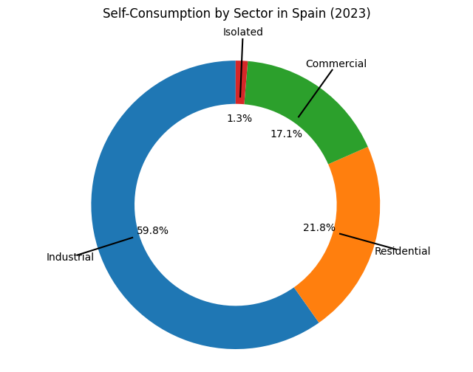
Problem definition – Spanish Framework
Self-consumption: isolated from the grid
2023
+ 1.706 MW capacity
- 32 % yearly increasement
AGC Flat Glass Ibérica – Sagunto (Valencia)
Reference: Spanish Photovoltaic Union (UNEF, unef.es)
Notes:
In contrast, self-consumers are typically smaller producers who face challenges in selling their energy to the public grid. So are not connected, at first.
Most of these are industrial and residential users.
Interestingly, their numbers are decreasing at twice the rate compared to other case.
The key question is, why?

Slide 5
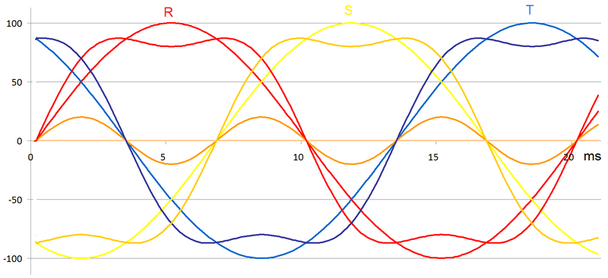

Problem definition – Spanish Framework
self-consumption vs production
Production
Injection Quality Standards
Extensive and strict regulations Governed by Royal Decree 244/2019, Royal Decree 413/2014, and international standards such as IEC 61000-3-2 and IEC 61000-3-12...
Key investment for assuring high-quality generation:
Voltage control
Frequency control
Power factor management
Harmonic and distortion control
Reactive power management
Anti-islanding protection
Notes:
In Spain, multiple layers of regulation have created a clear barrier that increasingly restricts PV installations.
These requirements force substantial investments to meet grid-quality parameters for connection.
That may be understandable, but ultimately self-consumers find it very difficult to recoup the subsequent investments in very expensive devices.

Slide 6

Problem definition – Spanish Framework
self-consumption vs production
Self-consumption (the “choice” of small and medium producers, <100 kwp)
Zero injection rule
“No excess energy is injected back into the electrical grid” Regulation: UNE 217001 IN
Storage system keeps being unaffordable for small users
High cost of additional equipment, including expensive inverters with power-limiting capabilities.
Recently abled: using the public grid as a battery → expensive extra-devices needed
Reduced return on investment, impacting the financial viability of self-producers
Notes:
But it doesn't end there: self-consumption systems not connected to the grid -typically under ~100 kWp- are subject to the Zero-Injection rule.
It forbids exporting surplus energy into the grid.
So you must –either- tightly match your PV generation to local loads or sharply stop generation when batteries are full.

Slide 7
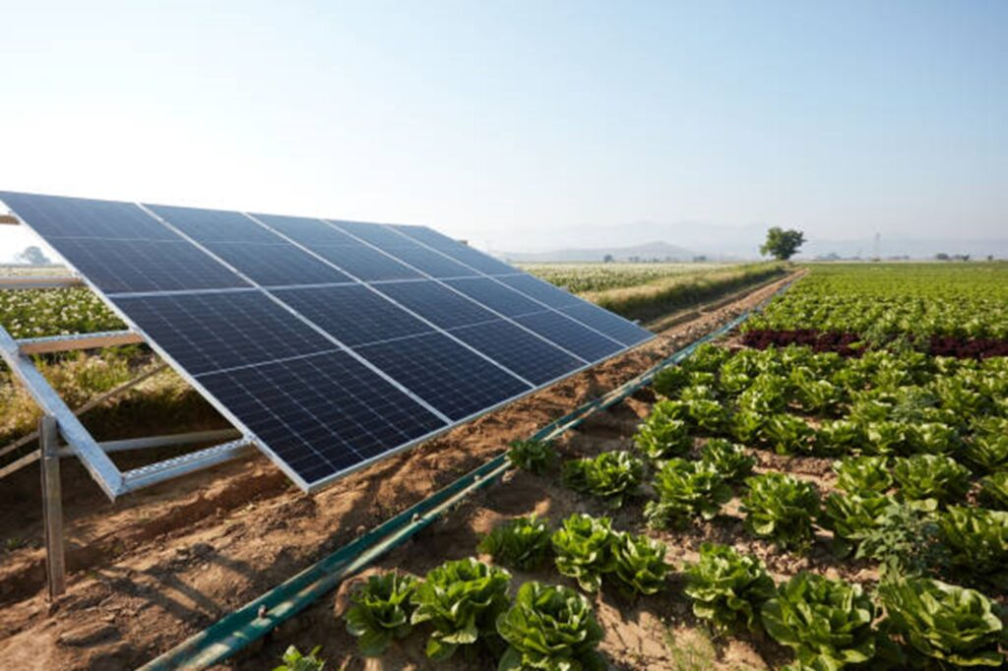
Problem definition – Spanish Framework
Spanish agricultural self-consumers are seeking solutions to ensure a return on investment in those cases of zero-injection rule
Flexibility in load connection
Accurate exploitation forecasting
Informed planning and optimization
Minimization of energy losses
Notes:
Spanish farms subject to the Zero-Injection rule need tools to size and fine-tune their installations so generation and local load intake are tightly matched. They therefore require strong forecasting capabilities to schedule load uptake strategically during production.

Slide 8
Use Case
Anonymized agrivoltaics deployment

Slide 9

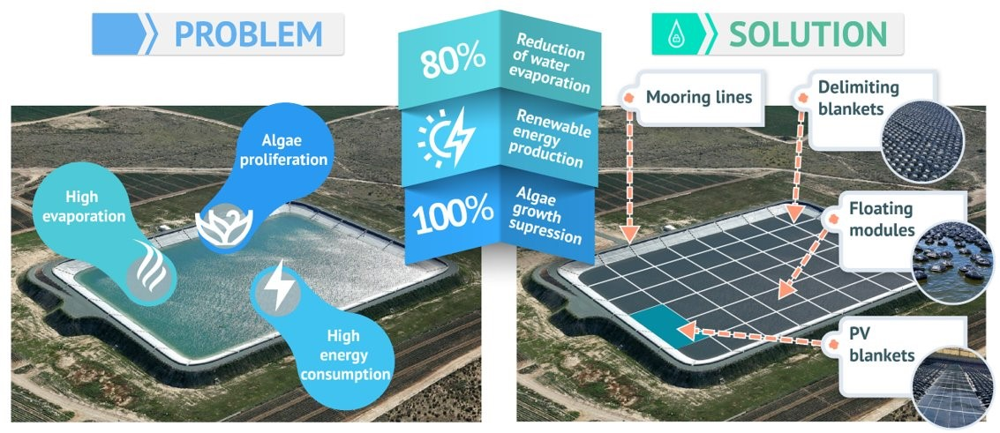
Use case – Anonymized agrivoltaics project
GEOGRAPHICAL LOCATION
Murcia (Spain)
Palmela (Portugal)
TYPES OF PARTNERS INVOLVED:
Irrigators' Community of Lorca
Farmers' Association: AVIPE
Technological Center: anonymized
Innovative Companies: ARANA, ARADA &GFI
PROJECT BUDGET:
1,8 M€ | 3 years
This project has received funding from the European Union’s LIFE 2021-2027 Prorgramme under grant agreement nº 101074546
Notes:
The anonymized project is a Horizon Europe initiative under the LIFE program, with a strong focus on sustainability.
Our consortium consists of six diverse partners, working together with nearly €2 million and a three-year timeline to tackle a significant challenge.
The project aims to achieve up to 80-85% control over water evaporation,
suppress algae growth without the use of algaecides
and generate renewable energy for irrigation large agricultural reservoirs.

Slide 10
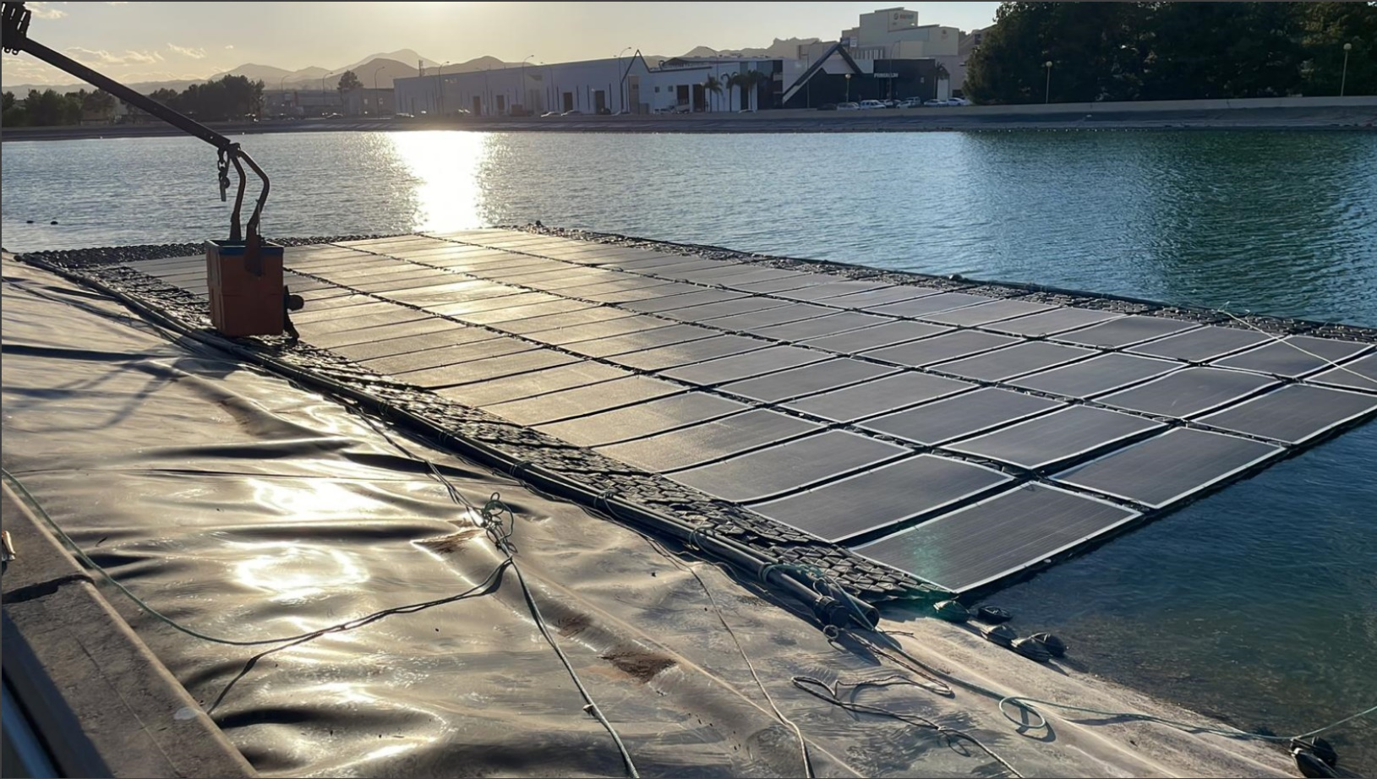
Use case – Anonymized agrivoltaics deployment (I)
Floating shetup
~ 26 x 11 m (85 x 39 feet)
Pannels:
Suman smf 310-5x12DW 310W
88 units
Capacity:
27,2 kWp
Notes:
The photovoltaic floating power plant is therefore a key component of our demonstrator site in Lorca, Murcia.
Here is a picture of the power plant during the early stages of the Lorca demonstration installation. 27 pike kilowat
On the right, you can find the plant's specifications.
Take a moment to enjoy the beautiful Murcia sunset.

Slide 11
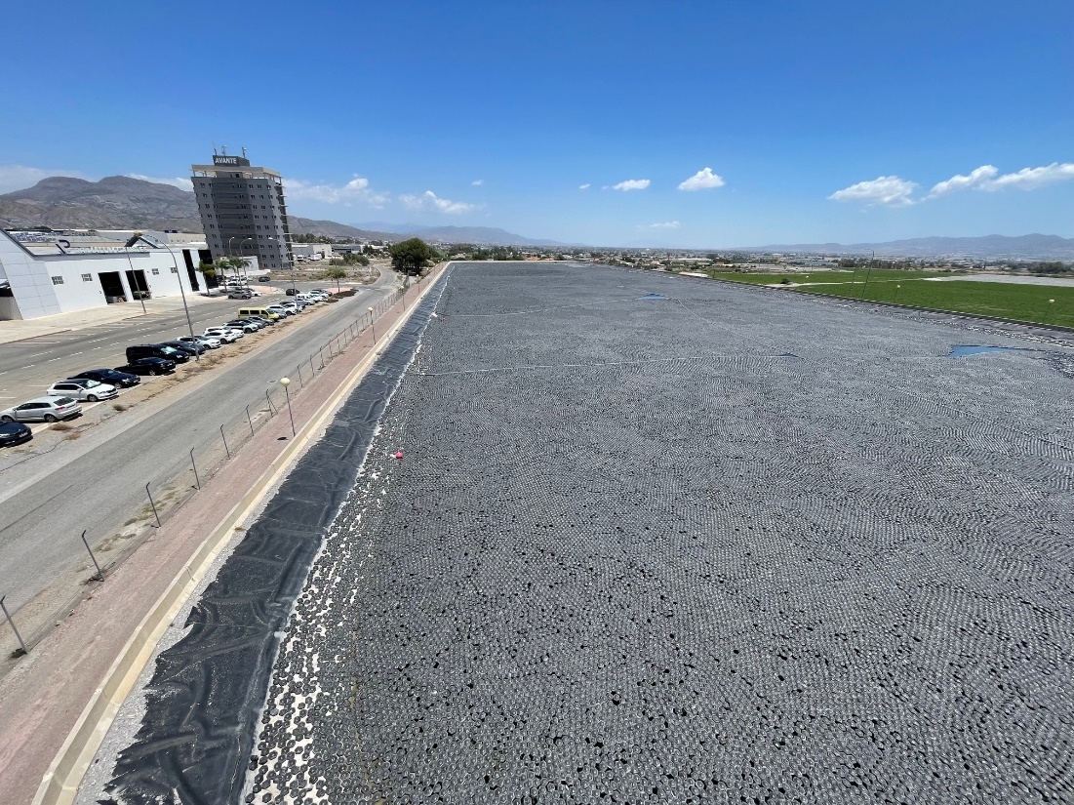
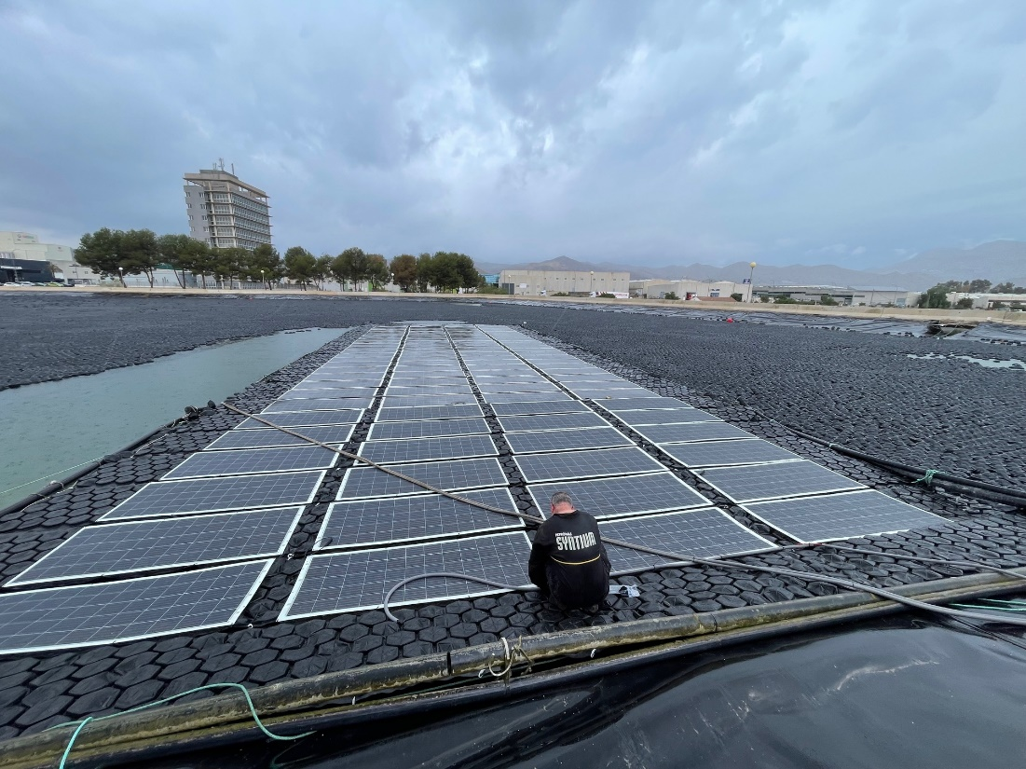
Use case – Anonymized agrivoltaics deployment (II)
Notes:
This is the fully covered water reservoir. What you see here is the complete deployment of thousands of individual floating modules alongside the floating power plant,
all installed and monitored together as one integrated system

Slide 12
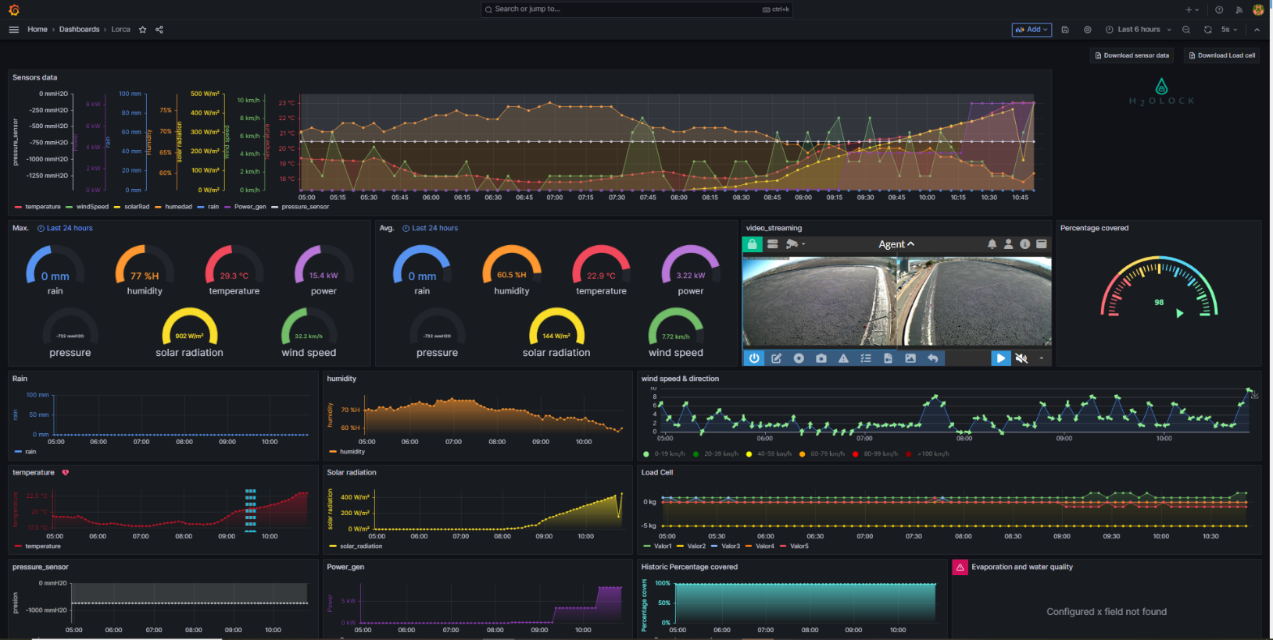
Use case – anonymized project | Problem definition
Primary user needs
Accurate short-term forecasting for the demonstrator in real-time
Informed planning and optimization of daily pumping operations
Notes:
Two main technologies were also proposed by the anonymized organization to complement the floating solution:
Accurate short-term forecasting for the demonstrator in real-time:
commercial tools are primarily focused on the design phase of PV plants, are not open-source, and cannot be integrated into dashboards.
We need to configure our own open-source tool to be implemented within the dashboard’s operational framework.
[Problem definition] To achieve an informed planning and optimization of daily pumping operations:
to maximize PV energy production, several pumping groups can be controlled through a PLC
Those pumps from the water wells up to the water pond,
It requires daily automated scheduling in base to a prediction of PV ‘free’ energy available.
This way, different pumping power levels will be activated and adjusted according to the expected daily energy production curve that has been predicted.
We don’t have a prediction. Need one.

Slide 13
Machine Learning
Applied to Photovoltaics

Slide 14
Machine Learning
EOA Literature: Top 10 publications from Q1 Journals
Ref | Title | Authors | Year | Citations | Journal | DOI
1 | Machine learning–assisted molecular design and efficiency prediction for high-performance organic photovoltaic materials | Wenbo Sun, et al. | 2019 | 156 | Science Advances | 10.1126/sciadv.aay4275
2 | Statistical Analysis and Development of an Ensemble-Based Machine Learning Model for Photovoltaic Fault Detection | Muhammad Hussain, et al. | 2022 | 15 | Energies | 10.3390/en15155492
3 | Machine learning property prediction for organic photovoltaic devices | Nastaran Meftahi, et al. | 2020 | 51 | Computational Materials | 10.1038/s41524-020-00429-w
4 | Condition Monitoring in Photovoltaic Systems by Semi-Supervised Machine Learning | Lars Maaløe, O. Winther, et al. | 2020 | 6 | Energies | 10.3390/en13030584
5 | Artificial Intelligence in Photovoltaic Fault Identification and Diagnosis: A Systematic Review | Mahmudul Islam, et al. | 2023 | 0 | Energies | 10.3390/en16217417
6 | Machine Learning Schemes for Anomaly Detection in Solar Power Plants | M. Ibrahim, et al. | 2021 | 28 | Energies | 10.20944/preprints202112.0481.v1
7 | Extreme Learning Machines for Solar Photovoltaic Power Predictions | S. Al-Dahidi, et al. | 2018 | 60 | Energies | 10.3390/EN11102725
8 | Deep and Machine Learning Models to Forecast Photovoltaic Power Generation | Sergio Cantillo-Luna, et al. | 2023 | 3 | Energies | 10.3390/en16104097
9 | Review on the Application of Photovoltaic Forecasting Using Machine Learning for Very Short- to Long-Term Forecasting | Putri Nor Liyana Mohamad Radzi, et al. | 2023 | 11 | Sustainability | 10.3390/su15042942
10 | Assessment of Machine and Deep Learning Approaches for Fault Diagnosis in Photovoltaic Systems Using Infrared Thermography | S. Boubaker, et al. | 2023 | 6 | Remote. Sens. | 10.3390/rs15061686
Notes:
After reviewing numerous papers, we found that this selection provides a comprehensive approach to AI applied to photovoltaic power forecasting.
We have included these references in this slide for further audience interest.
Now, we will highlight some key remarks extracted from here… next slide

Slide 15
Machine Learning
EOA Literature: Top 10 summary
Material design and efficiency prediction: [1][3]
Fault detection and diagnosis:[2][5][6][10]
Condition monitoring: [4]
Power forecasting: [7][8][9]
Not informed optimization techniques for model hyperparams
Rely on large and robust datasets for training
Novelty:
It faces the challenge with early-stage datasets (few months)
Non frequently used model (the XGBOOST) + informed optimization techniques
Notes:
Material design and efficiency prediction: ML models can establish relationships between chemical structures and photovoltaic properties, enabling fast screening and the acceleration of the development process of materials and silicium based technologies.
Fault detection and diagnosis: ML techniques are effective in detecting and diagnosing faults in pv systems, offering high accuracy and efficiency.
Condition monitoring: semi-supervised ML models can perform condition monitoring by leveraging unsupervised data for feature representation and classification.
Power forecasting: some ML models are applied to get accurate predictions and aiding in decision-making for energy management.
HOWEVER, these models typically rely on large and robust datasets for training, which limits their effectiveness when only early-stage data is available.
The novelty of this work is facing this challenge with employing a non frequently used model (the XGBOOST) and Bayesian optimization techniques.

Slide 16
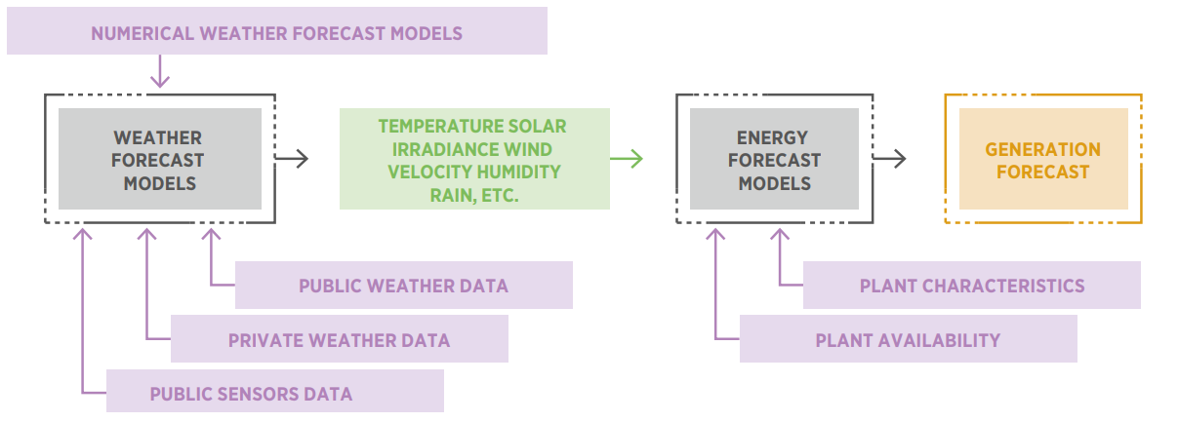
Machine Learning
Applied to Photovoltaics – Variable renewable energy (VRE) forecasting
International Renewable Energy Agency, Advanced forecasting of variable renewable power generation: Innovation Landscape Brief. 2020. [Online]. Available: www.irena.org
Notes:
This schema represents the common framework underlying state-of-the-art developments.
The work presented here builds on this framework, primarily focusing on the ingestion and curation of private weather data and the development of AI-based energy forecast models.
The goal is to be prepared for when our colleagues provide the weather variable forecasts, enabling us to produce daily power generation forecasts and integrate them into the project dashboard.

